Slide 1
REPORT #:
170701439
YOUR LOGO
HERE
REPORT Content
Yes hello this is Ben Wilson. I'm it's 25 April. And my code no. is 0721. We're here to Miller Farm today in Boone Iowa and we're working with soy beans. I sent for photos that relate to what we're looking at here today. Essentially These beans or at least(?) the. The two stage and we're doing a application of energy power at all(?) point(?) per acre. And also combining that with some bio Forge. That's at two point an acre an our intent here is two encourage the plans to store some energy. So that we can later access it when we get into the pod and this is the first of three applications. As mentioned we're actually be doing the application tomorrow on this field and make sure that this is reference later because we want to complete this story with the second and third application and assuming we get the results that we're looking for. We wanna compare this with our check. The first photo that I sent you'll see that there's a lane(?) down through the middle on the left is our check we will not be spraying that field and then from the lane to the right is is where will be applying the products that I've already mentioned so I think that's it. Thank you much. So long.
721
CODE#
Reported by:
Date/Time Reported:
Photos Sent:
NOTES:
Ben Wilson
4/26/16 09:15
4/26/16 09:22
Soy Beans
CAPTURE DATA From the Field … a service of The AgHUB
2225 Sycamore St, Harrisburg, PA 17111 717.232.6040

Slide 2
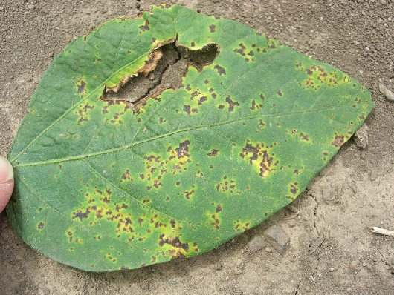
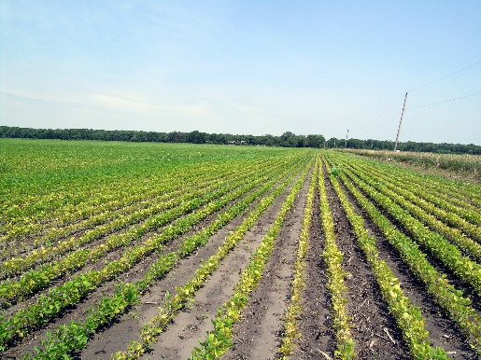
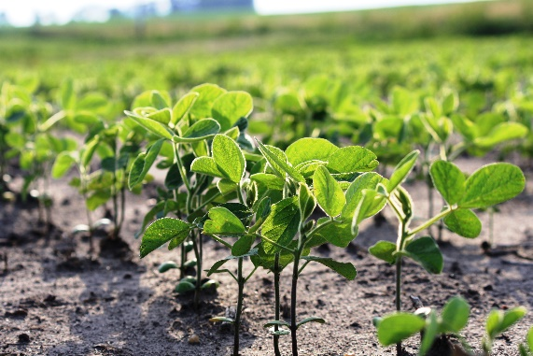
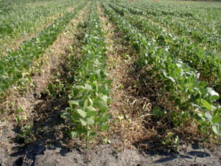
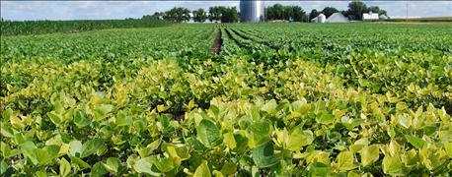
REPORT #:
170701439
YOUR LOGO
HERE
Photos:
CAPTURE DATA From the Field … a service of The AgHUB
2225 Sycamore St, Harrisburg, PA 17111 717.232.6040

